Slide 1



Linux file Description
By : Naveen Nayan
M.Tech(ES)
Batch(2016 - 2018)
School of Electronics, Devi Ahilya Vishwavidyalaya Indore

Slide 2
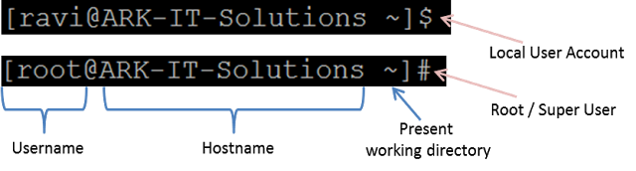
The Terminal
$ sign = local user/non-privilege user
# sign = Administrator/Privileged user
Notes:
Shells can be changed based the user compatibility and requirements, most of default shell is 'BASH'
Cat /etc/shells

Slide 3
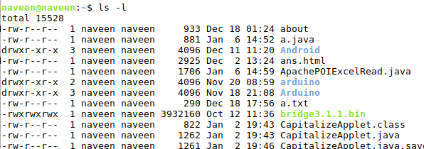
Home Directory
Each Linux user is assigned a home directory where they can keep files and build upon the structure by creating their own directories. The user home directories are identified by the Linux login user name and can usually be found under a parent directory called /home. The hidden files in the directory starts with .

Slide 4
.bash_history & .bash_logout
.bash_history
For users of the bash shell, a file containing up to 500 of the most recent commands available for recall using the up and down arrow keys.
.bash_logout
Script that is run by the bash shell when the user logs out of the system.

Slide 5
.bash_profile vs .bash_rc
.bash_profile is executed for login shells, while .bashrc is executed for interactive non-login shells.
What is a login or non-login shell?
When you login (type username and password) via console, either sitting at the machine, or remotely via ssh: .bash_profile is executed to configure your shell before the initial command prompt.
But, if you’ve already logged into your machine and open a new terminal window then .bashrc is executed before the window command prompt. .bashrc is also run when you start a new bash instance by typing /bin/bash in a terminal.

Slide 6
.bash_profile vs .bash_rc
Why two different files?
Let’s take an example, If you want to print a banner on your machine every time you login remotely by ssh, then you have to place that file in .bash_profile. If you want to load environment variable every time you start a terminal then .bashrc is used, like to create alias .bashrc is used.
To do : Fix it, sometime we don’t want to maintain two separate config files for login and non-login shells when to set a PATH ?
Notes:
if [ -f ~/.bashrc ]; then source ~/.bashrc fi

Slide 7
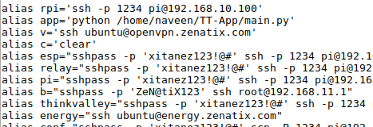
How to make a alias
Alias
Alias is nothing more than a keyboard shortcut, an abbreviation, a means of avoiding typing a long command sequence. The alias can be made both in .bashrc or .bash_profile
alias name=”command or task”
Eg : alias c='clear'

Slide 8
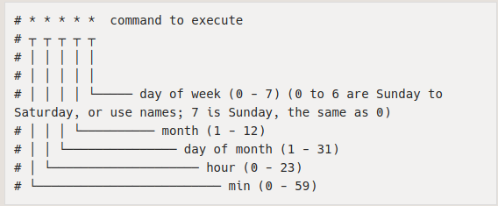
Scheduling task with Cron
Cron
Cron is a tool for configuring scheduled tasks on Unix systems. It is used to schedule commands or scripts to run periodically and at fixed intervals. Run crontab -e to edit a cron table and crontab -l to see all cron jobs.

Slide 9
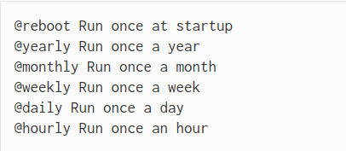
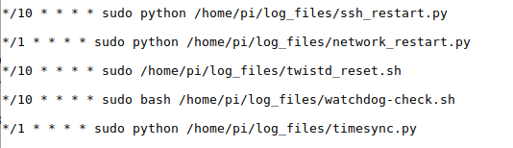
Scheduling task with Cron
Cron task with special keyword
Cron example

Slide 10
rc.local
In order to have a command or program run at boot, you can add commands to the rc.local file. This is especially useful when you want to run a program without configuration or a manual start. This file located at /etc/rc.local. Add commands below the comment, but leave the line exit 0 at the end, then save the file and exit.
WARNING
If your command runs continuously (an infinite loop) or is likely not to exit, you must be sure to fork the process by adding an ampersand to the end of the command. Otherwise, the script will not end and the Pi will not boot. The ampersand allows the command to run in a separate process and continue booting with the process running. Eg
python /home/pi/myscript.py &

Slide 11
references
[1]L. Architecture, "Linux Architecture", Tectm.com, 2018. [Online]. Available: http://www.tectm.com/2015/02/architecture-linuxarchitecture-kernel.html.
[2]"Scheduling tasks with Cron - Raspberry Pi Documentation", Raspberrypi.org, 2018. [Online]. Available: https://www.raspberrypi.org/documentation/linux/usage/cron.md.
[3]L. Unix and C. Hope, "Linux crontab command help and examples", Computerhope.com, 2018. [Online]. Available: https://www.computerhope.com/unix/ucrontab.htm.
[4]"Important Files and Directories - Linux Directory Tree - Linux directory architecture", Dba-oracle.com, 2018. [Online]. Available: http://www.dba-oracle.com/linux/important_files_directories.htm.
[5]"rc.local - Raspberry Pi Documentation", Raspberrypi.org, 2018. [Online]. Available: https://www.raspberrypi.org/documentation/linux/usage/rc-local.md..

